Slide 1



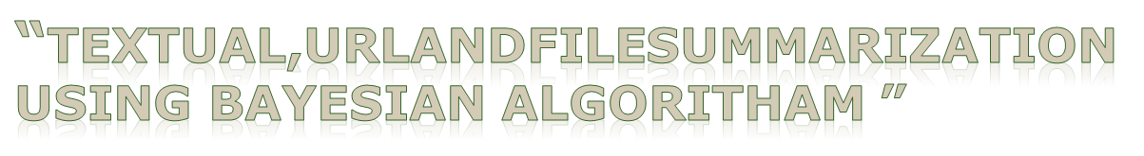
Guide Name :
Mr. M. EZHILVENDAN B.Tech., M.E.
Assistant Professor/IT
Project Members
1. R.Tamizhselvan (420418205304)
2. K.Sri kandhan (420418205303)
3. R.Prithviraj (420318205302)

Slide 2
CONTENT
Abstract
Literature Survey
Problem Statement
Existing System
Proposed System
System Architecture
Goals
Pre Processing Steps
Algorithms and Techniques
Integer Linear Programing
Hardware & Software Requirements
Modules & Descriptions
Quick Glance Summarization
GUI Home Page
Output Screenshots
Conclusion
Future Work
Reference
B.Tech - Information Technology

Slide 3
ABSTRACT
The project entitled TEXTUAL, URL and File summarization aims at creating a summary of a certain document that contains the most important information of the original one. Summarization of multi-documents aims to generate a concentrated version of the document while keeping the main information. Due to the massive amount of data these days, the importance of summarization arises. The TEXTUAL, URL and File summarization has the potential to reduce the time, required to familiarize oneself with the subject of studies by condensing long-form detailed descriptions to concise, meaning-preserving synopses.
B.Tech - Information Technology

Slide 4
Literature Survey
[1] M. Jang and P. Kang, "Learning-Free Unsupervised Extractive Summarization Model," in IEEE Access, 2021.
[2] F. Boudin, H. Mougard, and B. Favre, ``Concept-based summarization using integer linear programming: From concept pruning to multiple optimal solutions,'' in Proc. Conf. Empirical Methods Natural Lang. Process.,2018
[3] J. Devlin, M.-W. Chang, K. Lee, and K. Toutanova, ``BERT: Pre-training of deep bidirectional transformers for language understanding,'' 2018,
B.Tech – Information Technology

Slide 5
PROBLEM STATEMENT
To produce an automatic text summarization by preserving the meaning and the key content of the original document.
QUICK GLANCE generates a summary by extracting proper
set of sentences from a document or multiple documents.
It aims to produce an essence of the given documents.
B.Tech - Information Technology

Slide 6
Existing system
Existing systems include text summarizations.
It has traditionally been focused on text input.
There can be used only one format of the summarization.
B.Tech - Information Technology

Slide 7
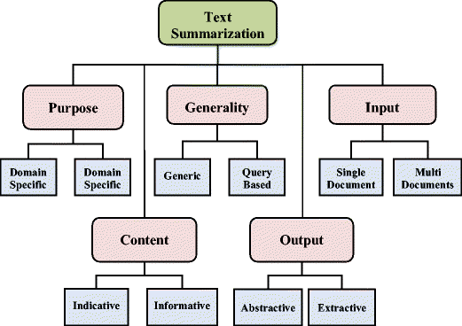
Architecture of Existing System
B.Tech – Information Technology

Slide 8
Proposed system
In Previous Version Only One Format Is allowed To Summarize the text
In This Version More Than one format is allowed To summarize the text ( URL , TEXT , DOCUMENT )
B.Tech - Information Technology

Slide 9
Architecture of Proposed System
1
2
Document
Sentences
Sentence vector
3
Summary
Principal Sentences
Sequential Information
5
4
Pre-processing 2. Pre-trained sentence model
3. Positional encoding method 4. PCA (PRINCIPAL COMPONENT ANALYSIS)
5. ILP(INTEGER LINEAR PROGRAMMING)
B.Tech – Information Technology

Slide 10
Goals:
Preserve the meaning and key of the data.
Resource effective.
Balanced results.
User-friendly.
Architectural pattern.
B.Tech - Information Technology

Slide 11
Pre-processing steps:
Tokenize on white space
Convert into lower case
Remove punctuations from each tokens
Remove tokens with numbers
Remove empty strings
B.Tech - Information Technology

Slide 12
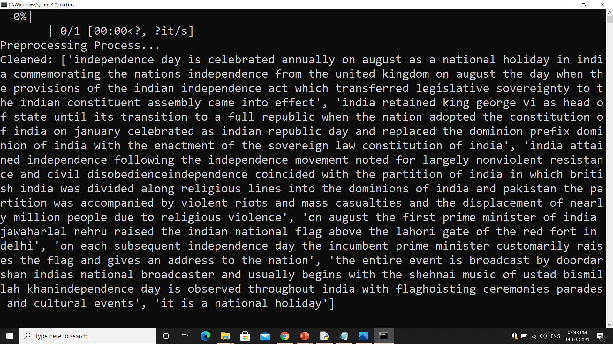
B.Tech - Information Technology

Slide 13
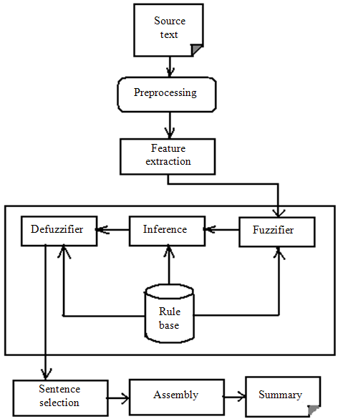
System Architecture:
B.Tech - Information Technology

Slide 14
Tech stack
Python
Django
HTML
Numpy, Pytorch
CSS
BS4 , pulp
Bootstrap
Sklearn
Front-End
NLTK
Back-End
B.Tech - Information Technology

Slide 15

Integer Linear Programming
1. Formulation - reduce redundancy
2. Sentence Pruning - reduce complexity
B.Tech - Information Technology

Slide 16
Hardware requirements
System runs on any regular PC/Laptop
If the user intends on training the model on a different dataset, then a machine with 4 GB or more
RAM and processor of 2.7 GHz or more is required.
Software requirement
Any modern web browser
Language Used :Python environment
Libraries/Toolkits :NLTK , Sci-kit Learn , Keras , Pandas , Numpy
Webframe Used : Flask
B.Tech - Information Technology

Slide 17
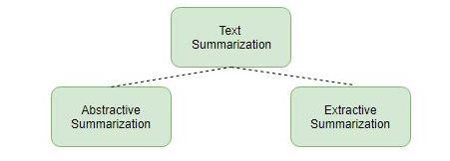
MODULES
List of Modules:
1. Extractive Summarization
2.Abstractive Summarization
B.Tech - Information Technology

Slide 18
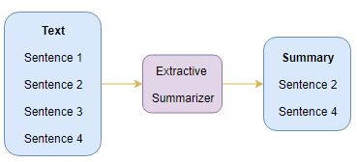
Extractive Summarization
In Extractive Summarization, we are identifying important phrases or sentences from the original text and extract only these phrases from the text. These extracted sentences would be the summary.
B.Tech - Information Technology

Slide 19
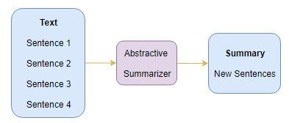
Abstractive Summarization
In the Abstractive Summarization approach, we work on generating new sentences from the original text. The abstractive method is in contrast to the approach that was described above. The sentences generated through this approach might not even be present in the original text.
B.Tech - Information Technology

Slide 20
QUICK GLANCE SUMMARIZATION
Here we are using three strategy Summarization Techniques :
Textbox Summarization
Uniform Resource Locator(URL) Summarization
File Summarization
B.Tech - Information Technology

Slide 21
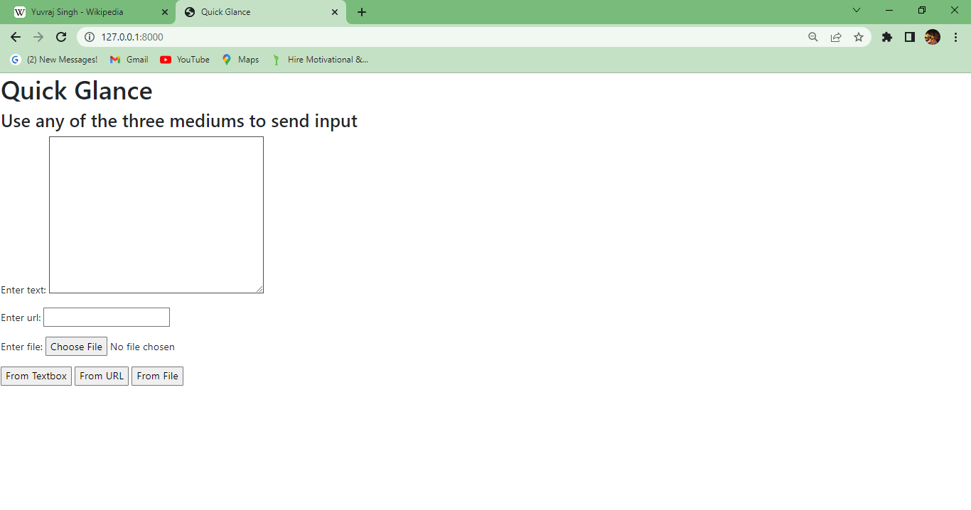
GUI HOME PAGE
B.Tech - Information Technology

Slide 22
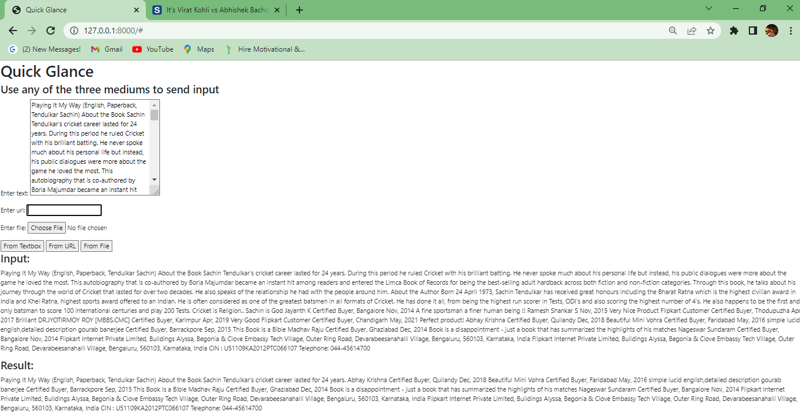
OUTPUT
B.Tech - Information Technology

Slide 23
CONCLUSION
A user-friendly text summarizer, the QUICK GLANCE is proposed efficiently by retaining the intrinsic information.
Experimental results revised that the Quick Glance provides well organized summary with needed information for non-critical applications like review, news glance etc., in an user-friendly manner.
B.Tech - Information Technology

Slide 24
FUTURE WORK
Here, the appropriate number of sentences in the summary will be decided by PCA using a variance preservation ratio β.
In future, PCA can be replaced with Linear Discriminant Analysis (LDA), and non-negative matrix factorization (NMF).
As of now, the summarized output is displayed in the GUI’s Homepage. Futureworks can include that the output can also be sent to the users valid mail.
It can be also implemented as a mobile application which will help out the students for quick grasping of the context.
B.Tech - Information Technology

Slide 25
REFERENCES:
IEEE Paper : https://ieeexplore.ieee.org/document/9321308
PE: https://www.youtube.com/watch?v=dichIcUZfOw
https://www.youtube.com/watch?v=mMa2PmYJlCo
Attention : https://www.geeksforgeeks.org/self-attention-in- nlp-2
Q, K, V : https://www.coursera.org/lecture/attention-models-in-nlp/
dot-product-attention-lO5yN
B.Tech - Information Technology

Slide 26
THANK YOU ...
B.Tech - Information Technology

